Slide 1
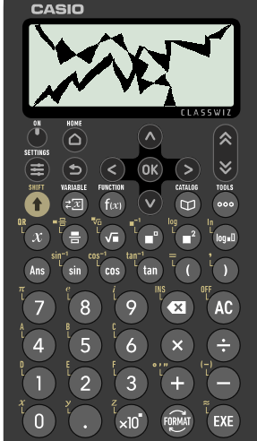
Divisibility tests for 2 and 3
Task A: Any even number is a multiple of 2
Using a test of divisibility by 2, identify all the multiples of 2 from the list below:
3 284 738
2 478 349
999 111 333
445 534
390
1115
222 222 222
2) Izzy’s calculator has broken.
She knows the number on the screen :
is a multiple of 2
has exactly 5 tens
is a 4 digit number
is greater than 8600
Less than 8660
What could her number be?
8650
8652
8654
8656
8658

Slide 2

Divisibility tests for 2 and 3
Task B: Divisibility tests for multiples of 3
1a) Identify all the multiples of 3 from the list.
234, 1398, 20 495, 593, 56 576
1b) Identify all the multiples of 2 and 3 from the list.
325, 139, 120 490, 594, 656 578 452
=29
2+3+4
=9
5+6+5+7+6
1+3+9+8=
21
2+4+9+5
=20
2+9+3
=17
=48
1+2+4+9
6+5+6+5+7+8+4+5+2
=16
5+9+4
=18
2) Here are five cards, each with a digit.
Only using 4 cards,
make a 4 digit number which is a multiple of 3?.
make a 4 digit number which is a multiple of 3 and 2.
Any four digit number using the digits 1, 1, 4 and 6.
Example 1146, 6114 or 4161
Any four digit number using the digits 1, 1, 4 and 6 with 4 or 6 in the ones column.
Example 1146, 6114 or 1614

Slide 3
Divisibility tests for 2 and 3
Task B: Divisibility tests for multiples of 3
3) Using the numbers below, fill in the Venn diagram.
248 4343 4350 312 492 892 091
111 7 77 555 555
Multiples of 2
Multiples of 3
7
248
4350
111
312 492
4343
555 555
4343
892 091
77
4) Here is an integer with a lot of digits.
999 898 969 698 751 986
Using the divisibility test, how do you show this is a multiple of 3?
9+9+9+8+9+8+9+6+9+6+9+8+7+5+1+9+8+6= 135
1+3+5 = 9
999 898 969 698 751 986 is divisible by 3
Mathematics in Education and Industry
v2.2

